Slide 1
Command Line Interface
BANKING

Slide 2
The Future Of Banking In 1969 Is Here… In 2025
Bank of CLI has brought a new way of banking through everyone’s terminal, so that everyone can enjoy banking from anywhere, everywhere
Enjoy abilities to have secure access to your accounts, manage your balance, make transactions, and have all records of everything you have ever done, all within the comfort of command inputs.

Slide 3
Before We Continue
Concepts that will be covered during this demonstration
Entity Relationships
JDBC
Postgres
Atomicity
Unit Testing
Maven

Slide 4
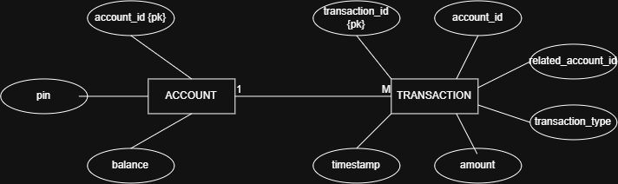
First, how did we get here?

Slide 5
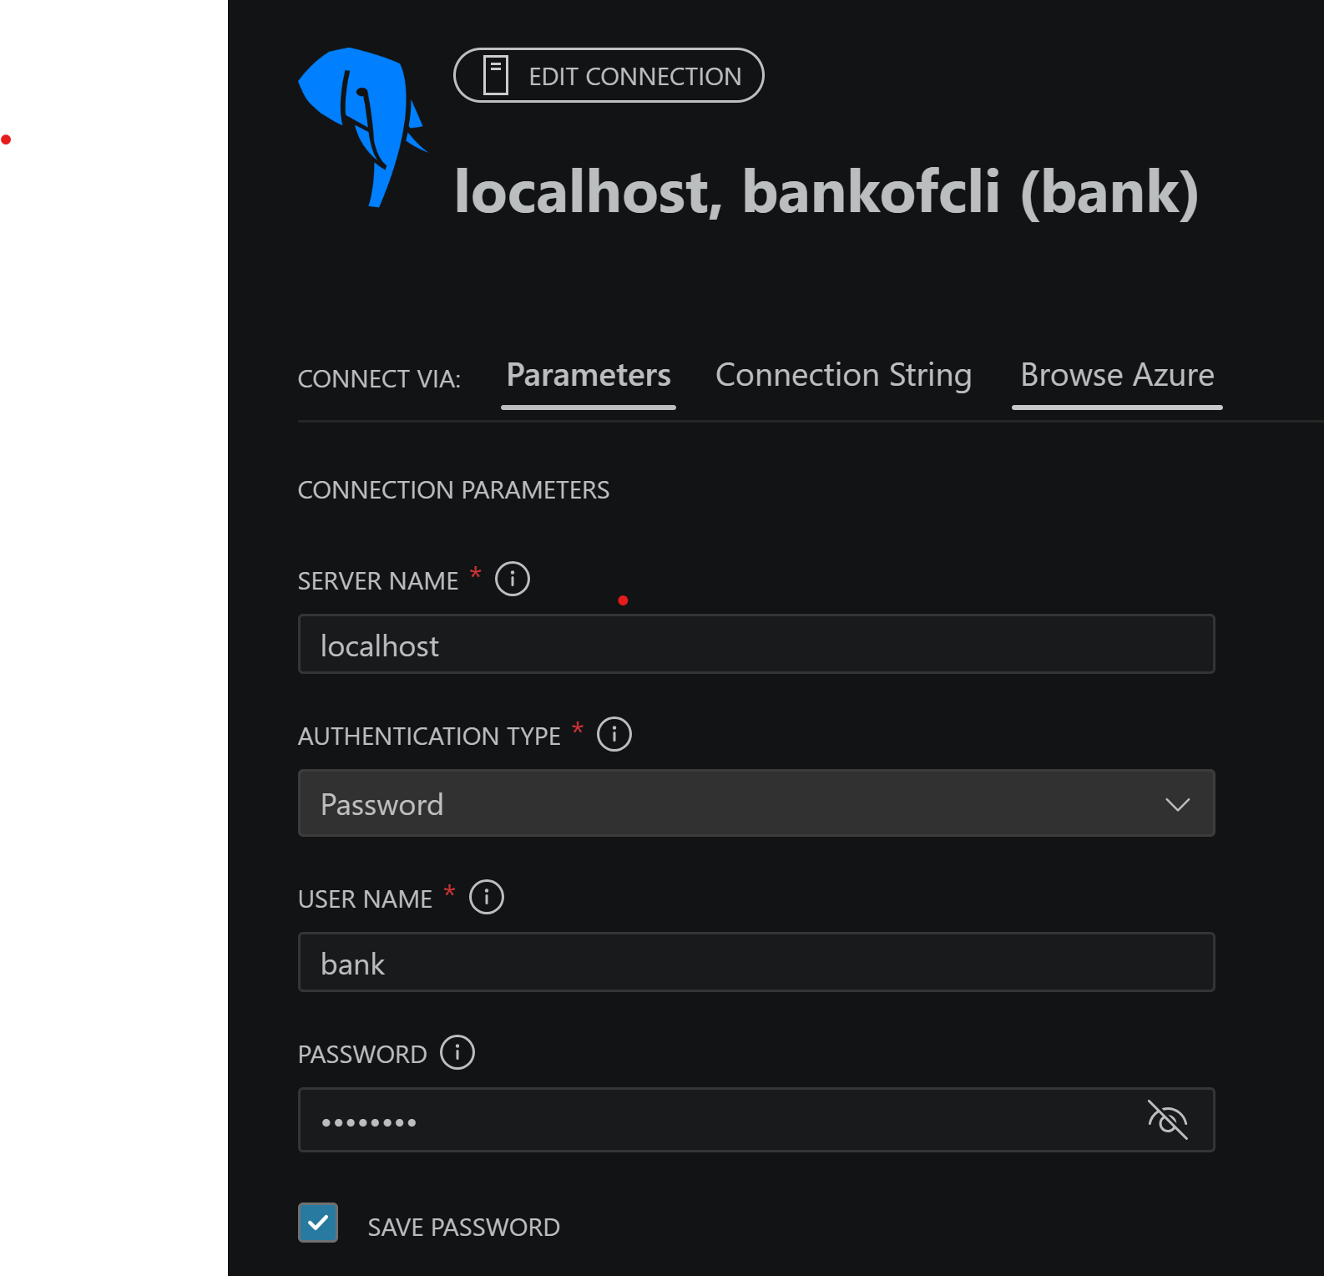
What’s next?
To track records in a database, Bank of CLI uses PostgreSQL.
THE modern way to manage databases and transactions among them.

Slide 6
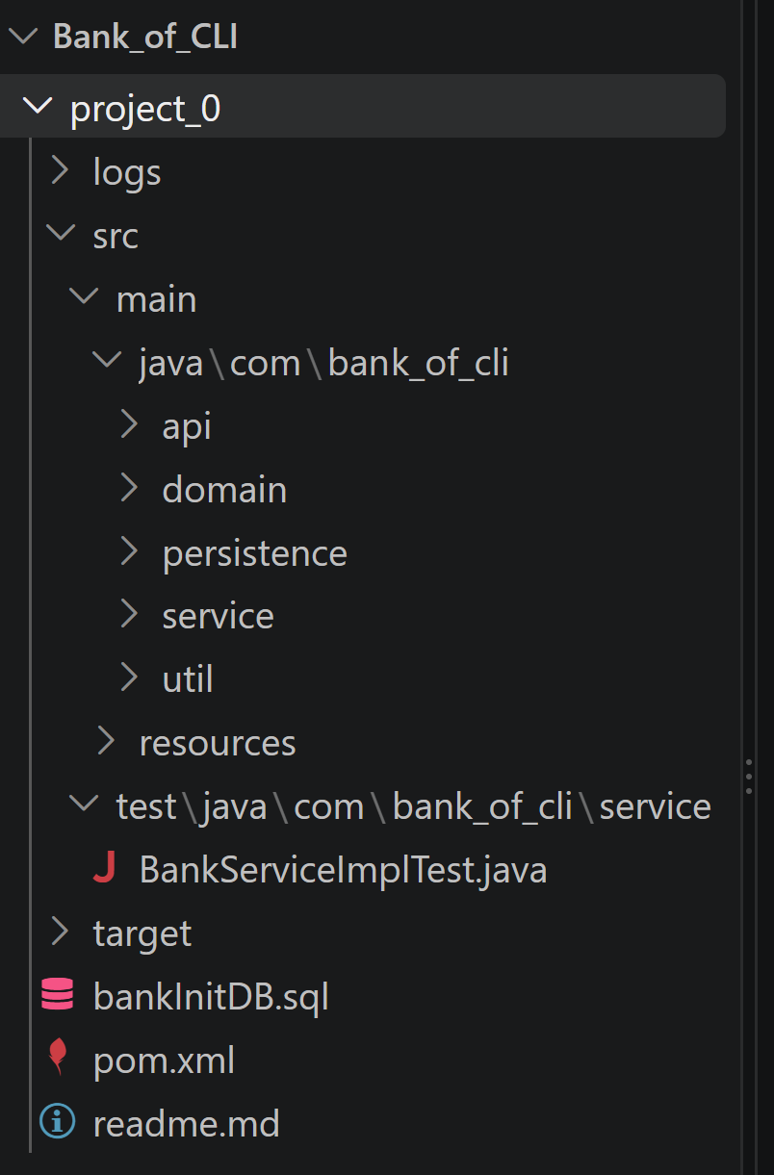
Where Does Java Play A Role In This?
Our application has to interact with the PostgreSQL Database. Thankfully, Java has us covered.
Maven - A build tool for Java projects that makes implementing dependencies easier. That way, we can use…
JDBC - A Java API that allows CLI (Java Application) to connect and interact with our PostgreSQL database.

Slide 7
Let Us Go Practice Banking

Slide 8
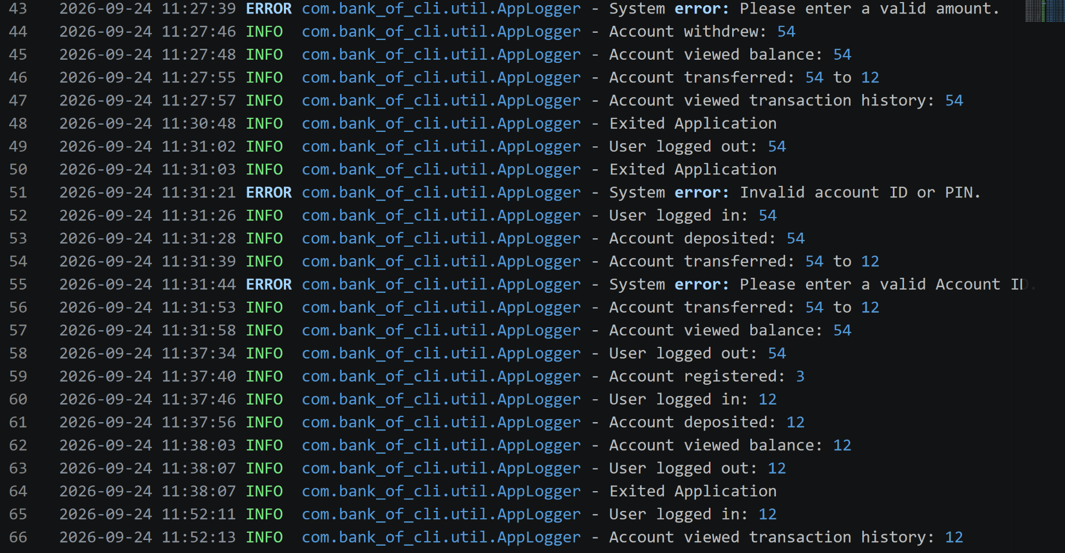
But Wait, There Is More!
Bank of CLI executives can view system logs of every interaction our customer makes.

Slide 9
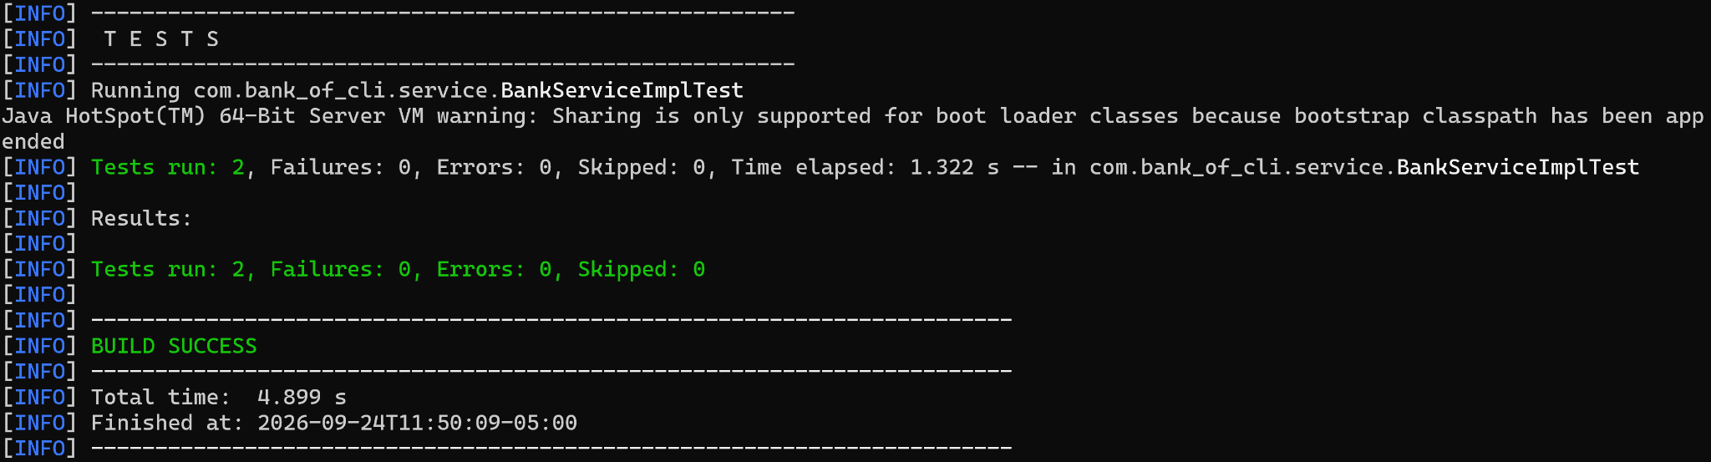
But Wait, There Is Even More!
Bank of CLI developers can test database functions too!

Slide 10
Need We Say More?

